Slide 1
2023年自動駕駛實務 final project Group 26
朱福城 P76107085 徐子桓E24084062 廖泓博E24086234 廖家問E24084729

Slide 2
Outline
LIDAR 3D Point Cloud
2D Object Detection
Kaggle Competition:
Lyft 3D Object Detection for Autonomous Vehicles
Waymo Datasets

Slide 3
Lyft 3D LIDAR POINT CLOUD

Slide 4



Dataset
85GB in zip.
10 host cars.
Capture on the roads of Palo Alto, California.
158,757 images for training.
192,276 images for testing.

Slide 5
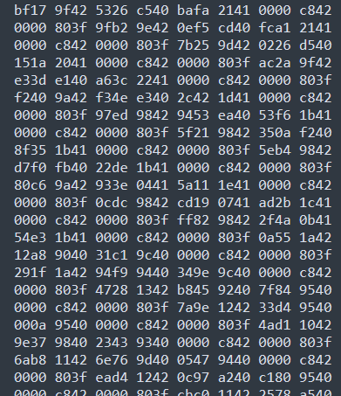
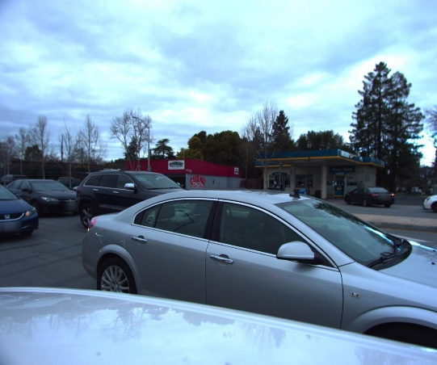
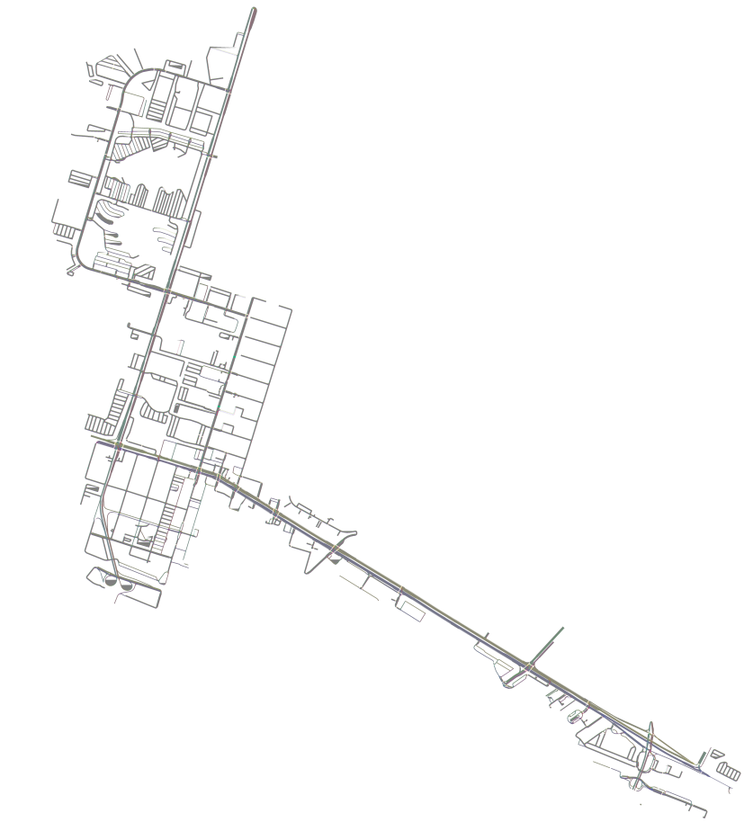
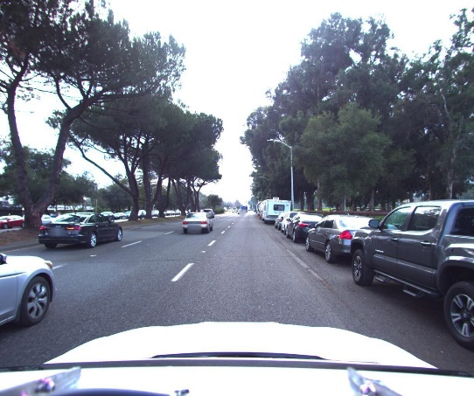
Dataset
LIDAR
Image
Map

Slide 6
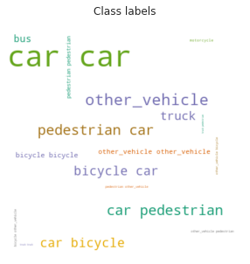
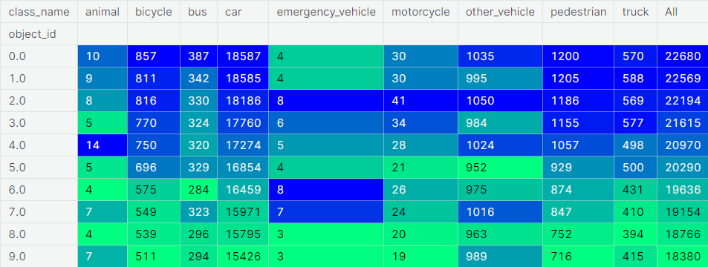
Dataset

Slide 7
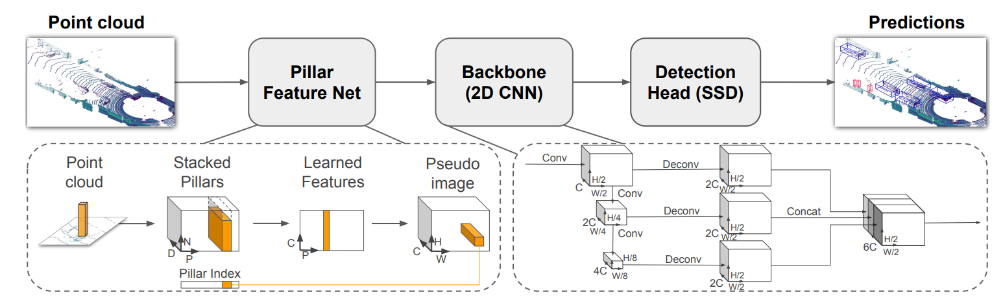
Model
PointPillars: Fast Encoders for Object Detection from Point Clouds

Slide 8
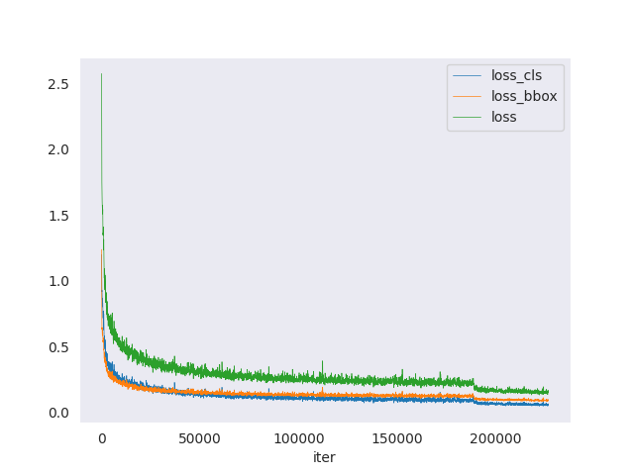
Training Curve

Slide 9
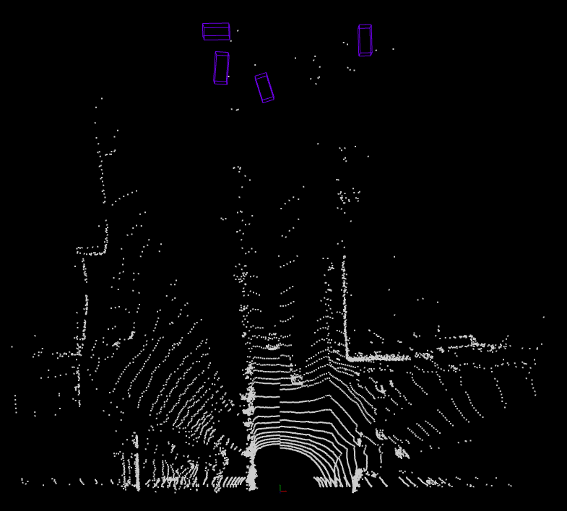
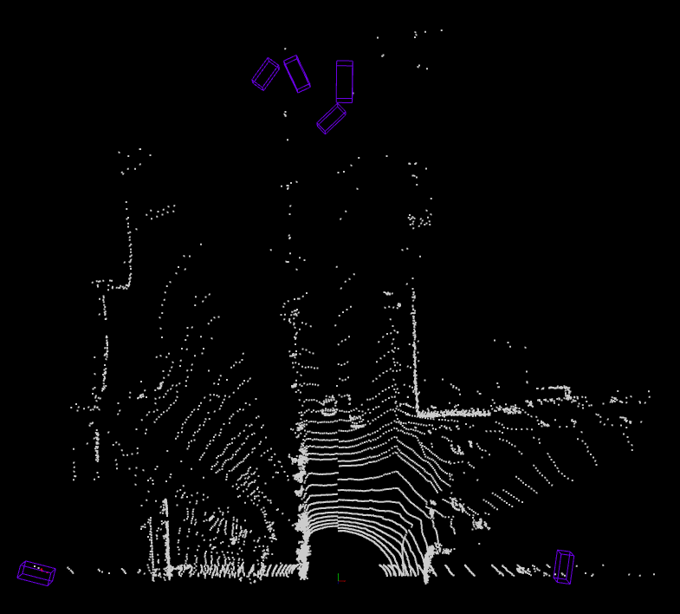
Results
3D box

Slide 10
Results
Class | mAP@0.5:0.95
Animal | 0.0
Bicycle | 0.068
Bus | 0.163
Car | 0.395
Emergency_vehicle | 0.0
Motorcycle | 0.022
Other_vehicle | 0.331
Pedestrian | 0.042
Truck | 0.142
Strict criterion for 3D detection methods.
The imbalance of annotations for different categories.

Slide 11
WAYMO 2D Object Detection

Slide 12
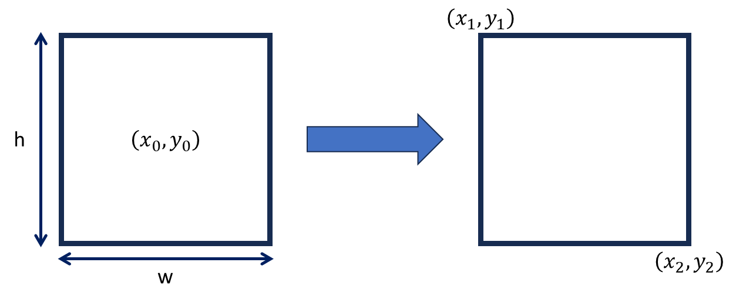
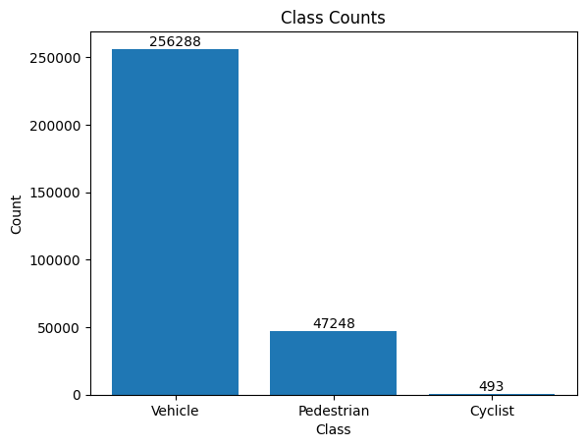
Waymo 2d Object detection on Google Colab
start
Training section
SSD ResNet50 V1
FPN 640x640
Environment setting
Model training
Save model
Data processing
Load pretrained model
Yes
Training?
Class distribution
Download dataset from google cloud
end
No
Inference and Evaluate section
~40GB dataset
Load model
Calculate
AP & AR
score
Inference on picture and video

Slide 13
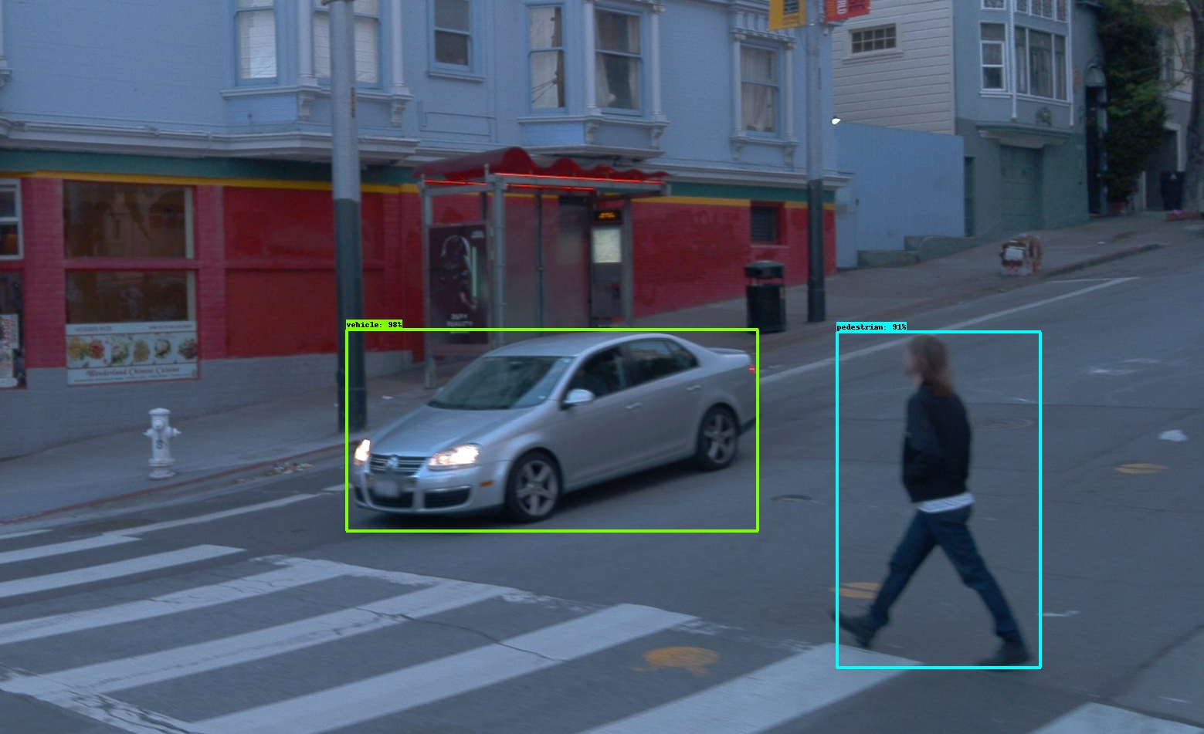
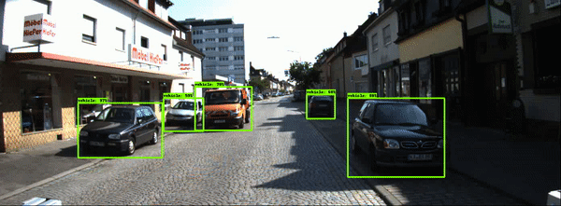
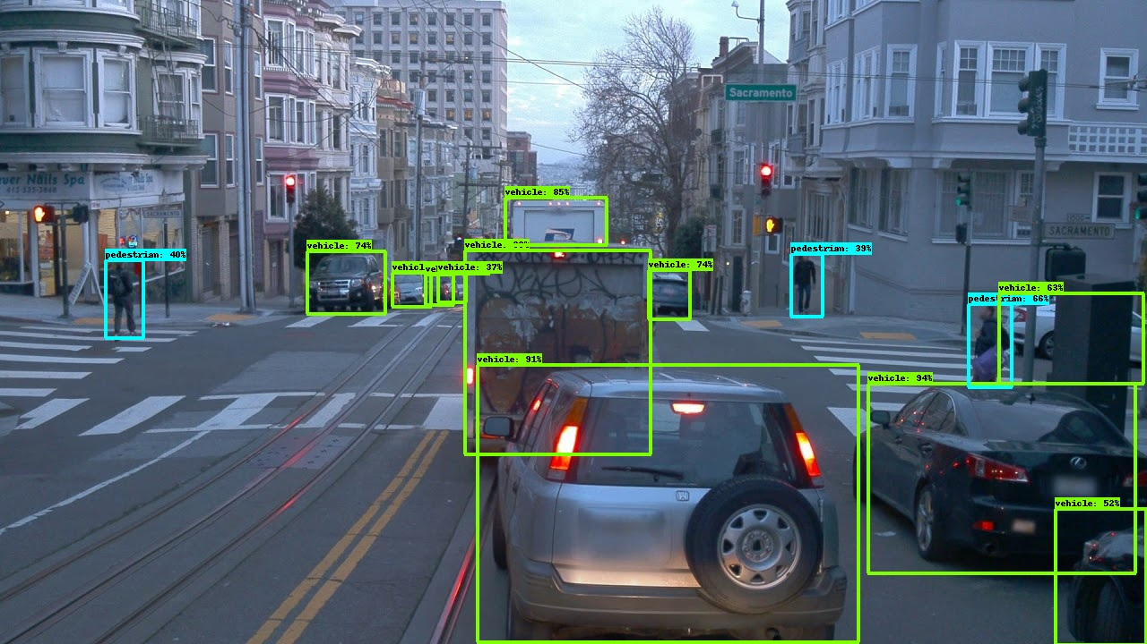
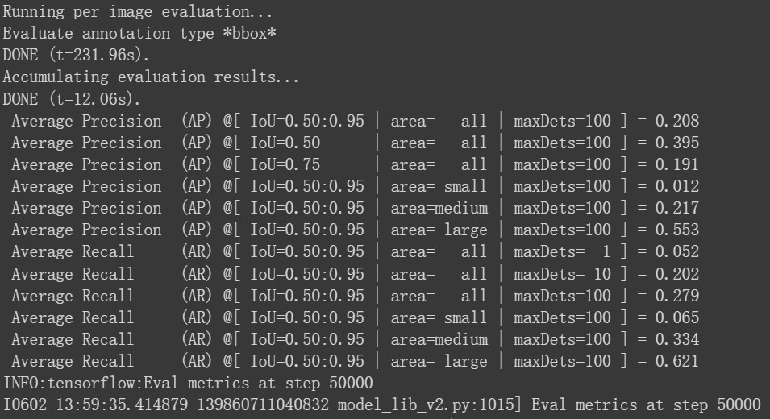
Results
Inference on images
Inference on KITTI dataset
AP & AR score

Slide 14
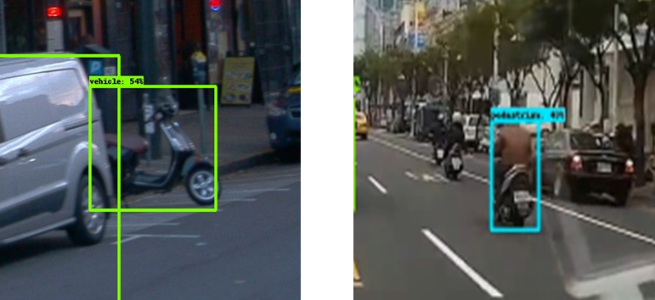
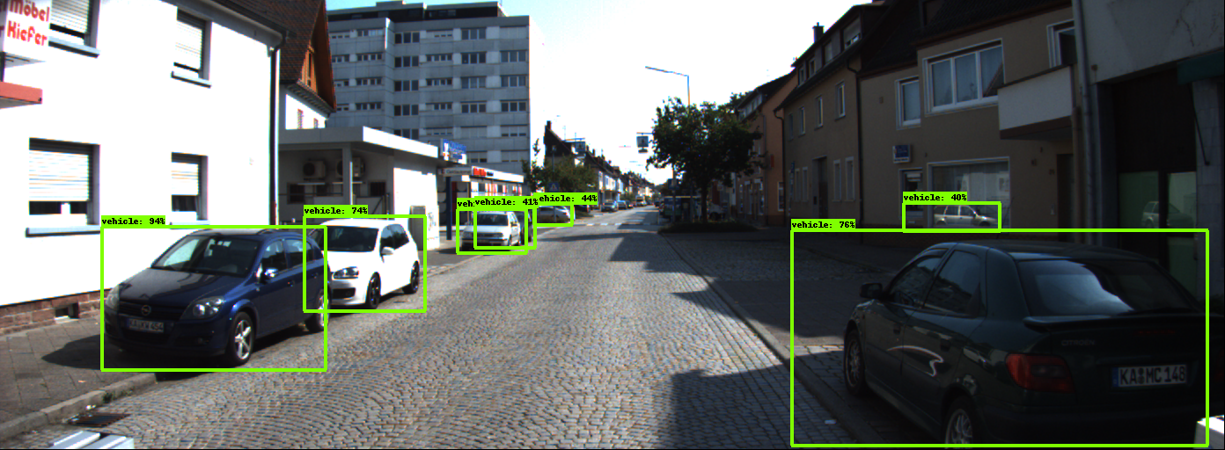
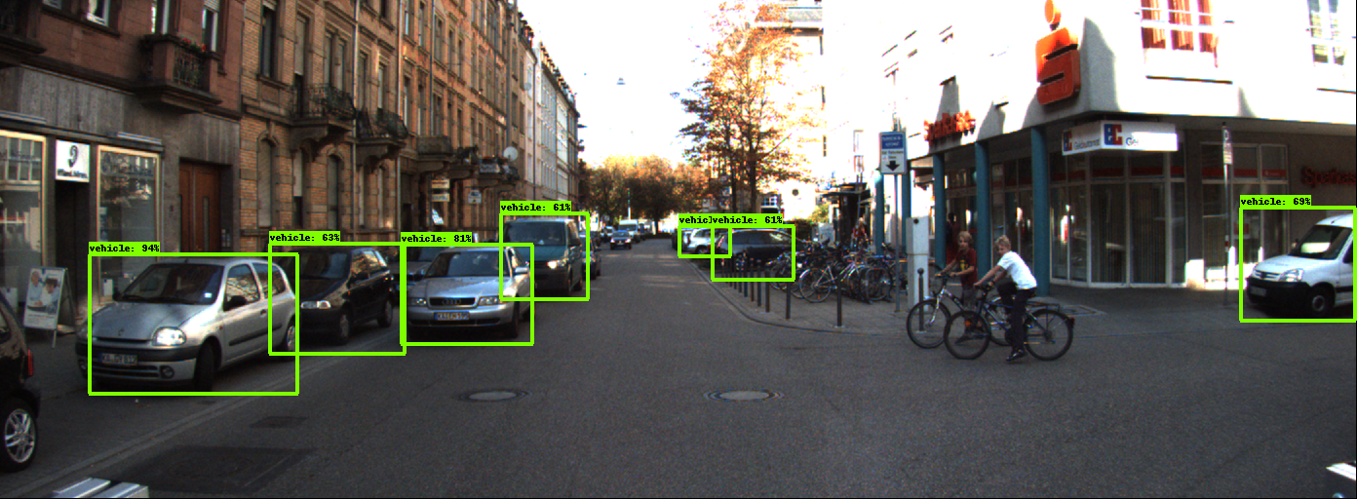
The challenges we encountered.
The laptop does not have a GPU suitable for machine learning tasks.
The dataset is too large to fit in Google Drive.
The model may predict motorcycles as pedestrian or vehicle.
The model fails to detect the cyclist class.
The model has the potential to detect objects inside mirrors.
Real object
Reflected object
???

Slide 15
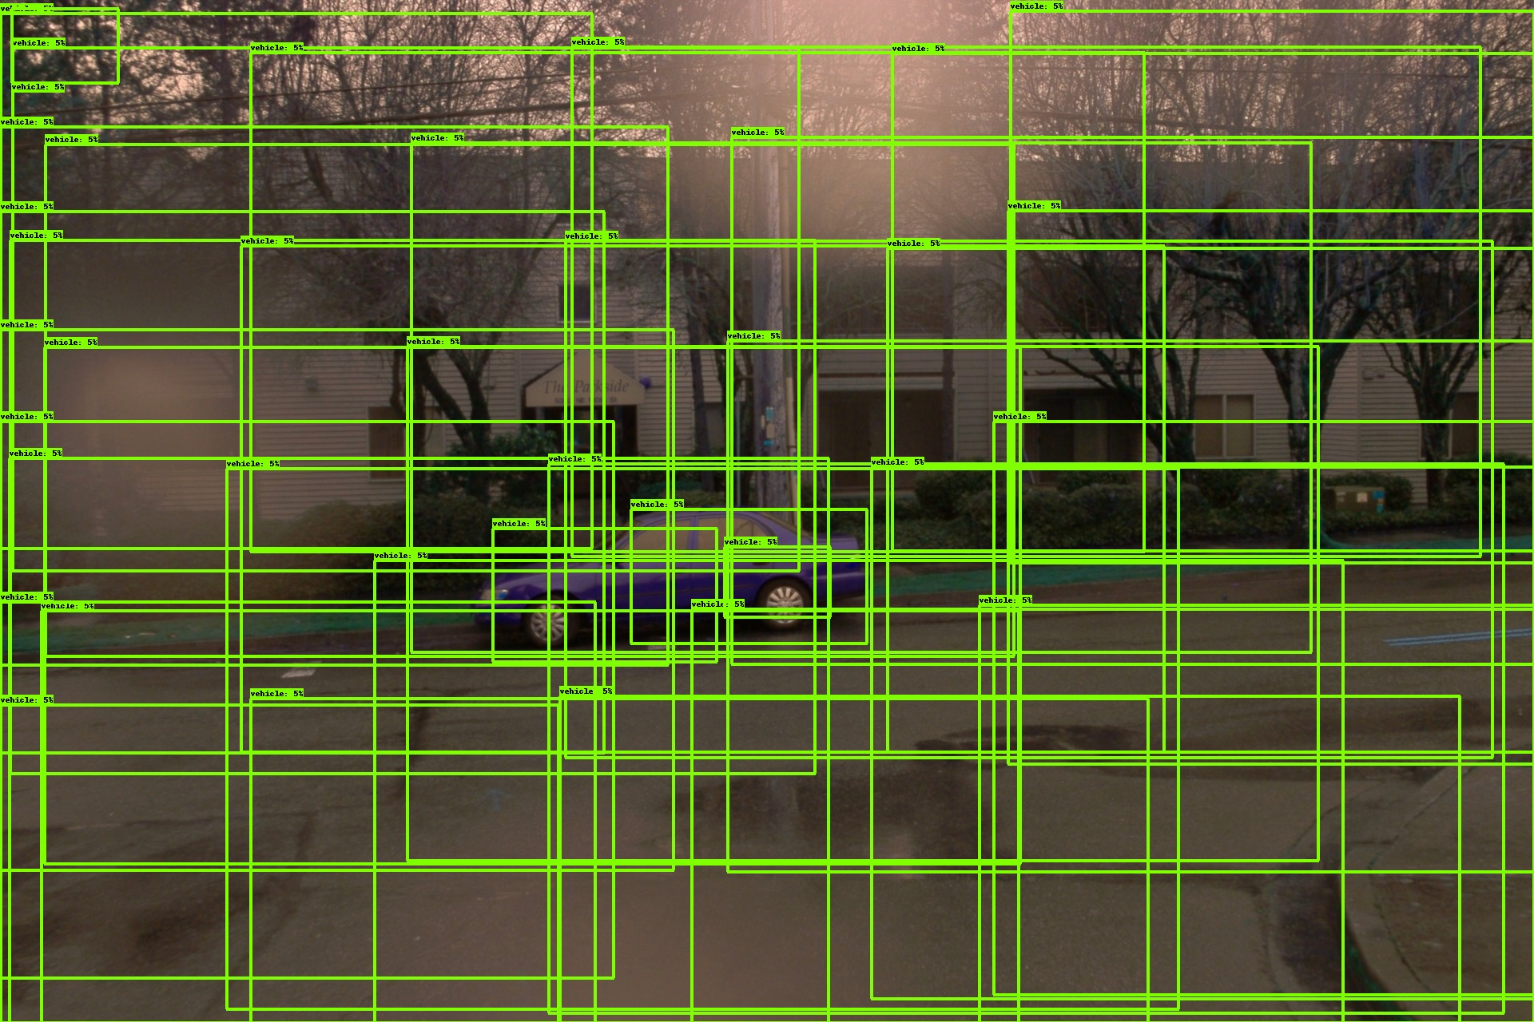
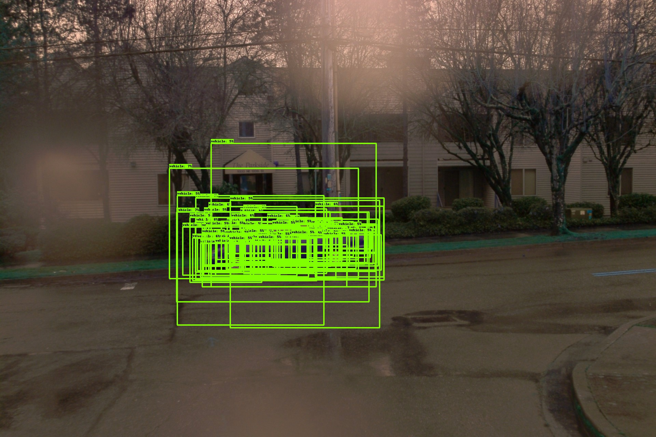
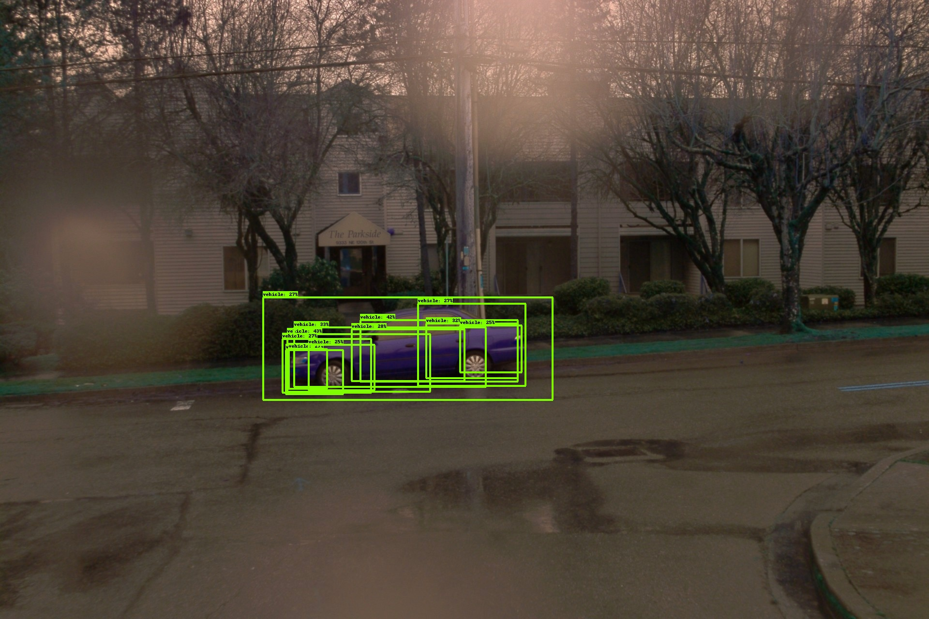
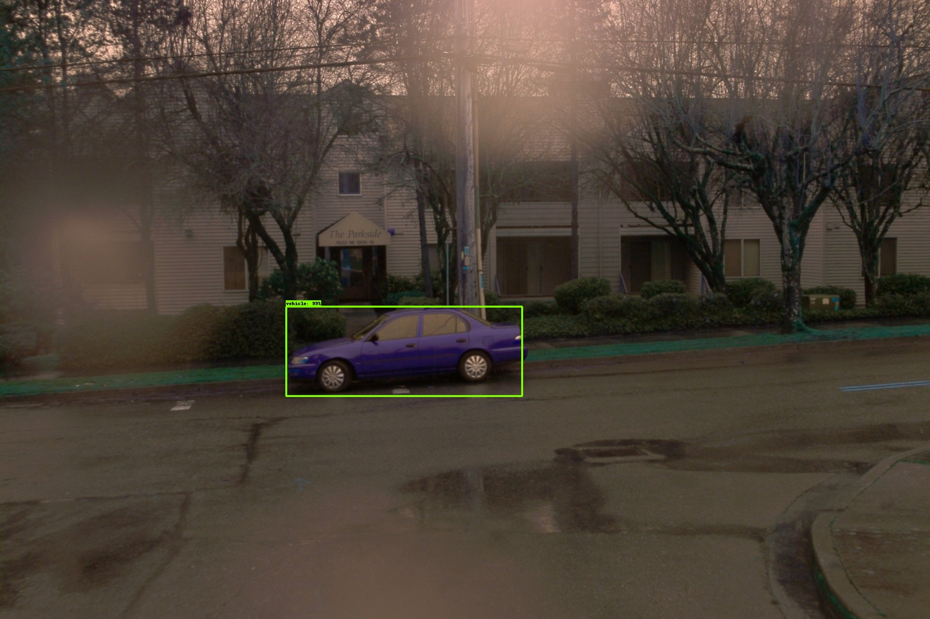
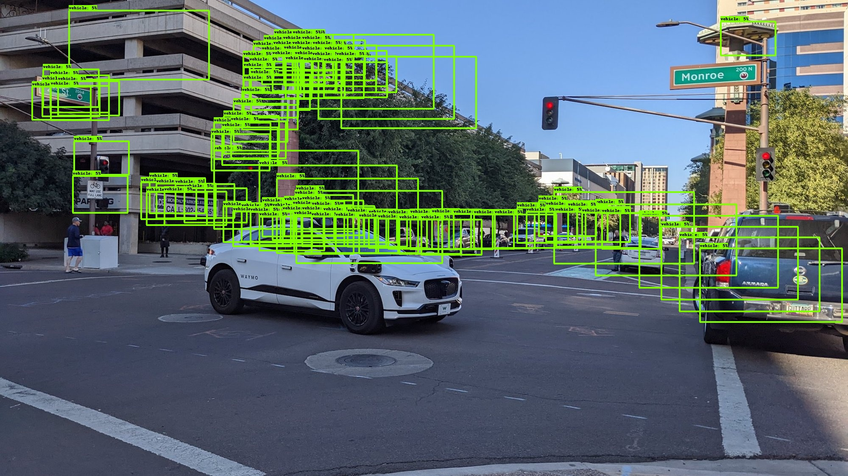
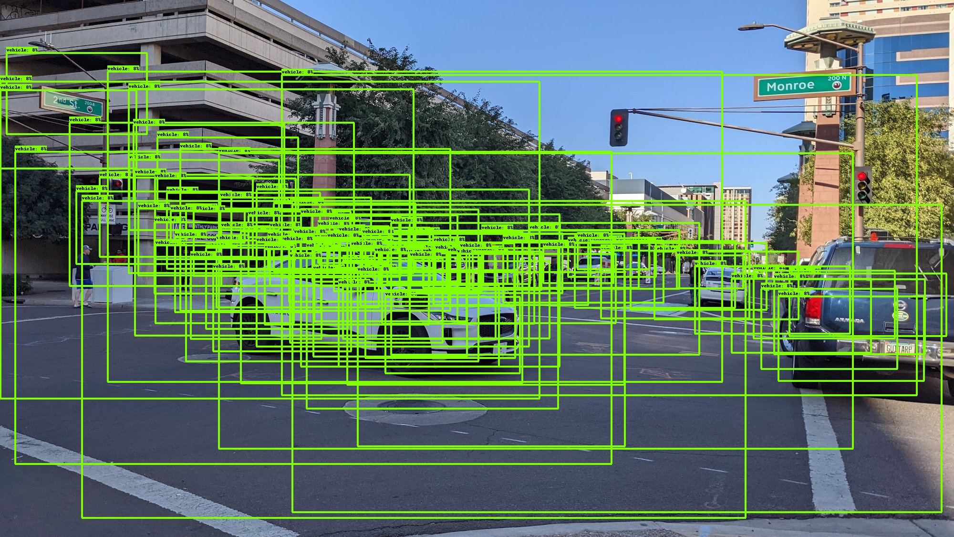
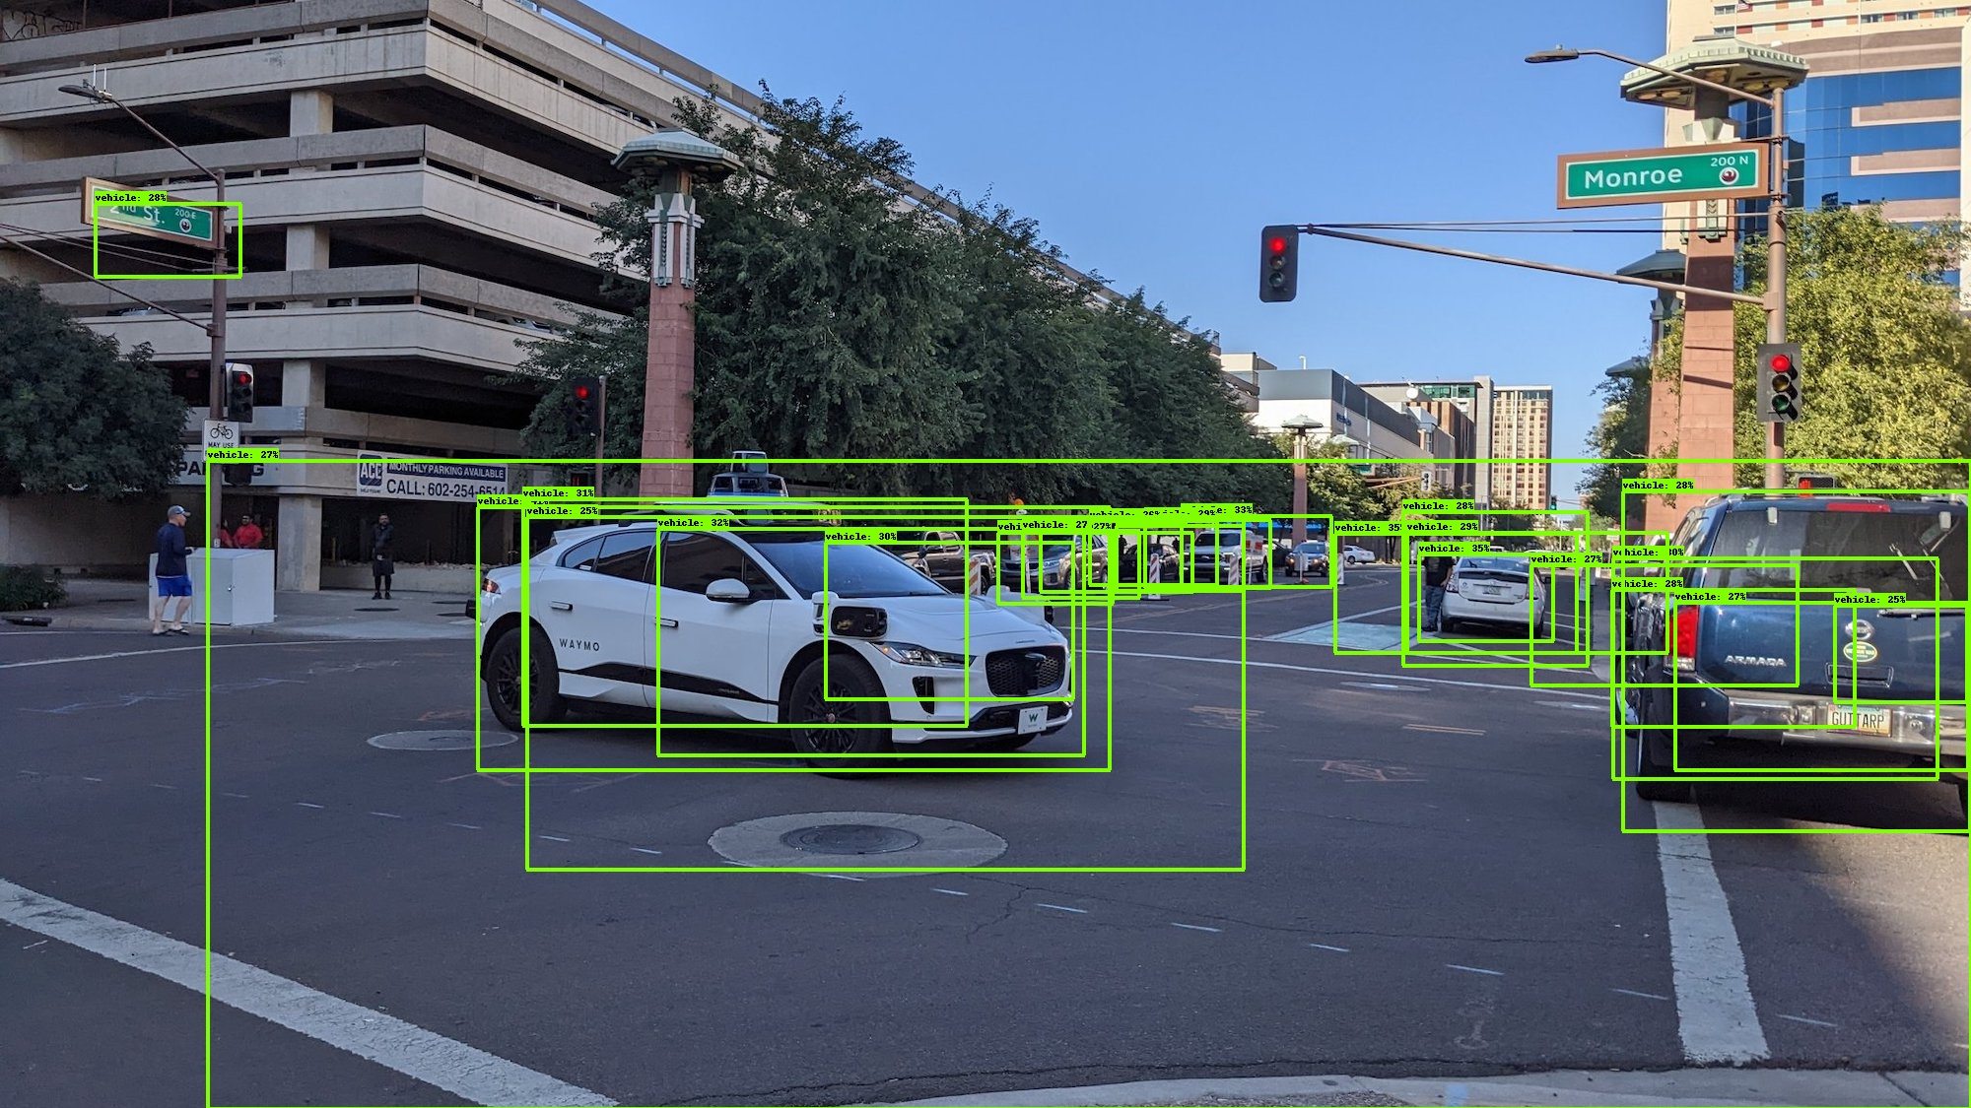
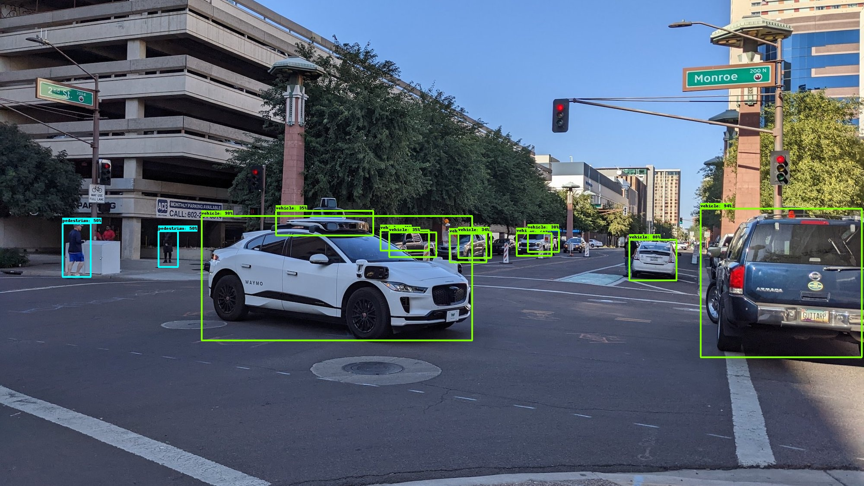
What have we learned from this project?
Training an object detection model is a time-consuming process, even when using a pre-trained model.
Knowing how to utilize pre-trained models available on GitHub and modify relevant configurations to accomplish our tasks.
During the training process, it is important to save the training progress at regular intervals.
Doing data exploration before training the model is crucial.
~ 1 hour
~ 3 hour
~ 5 hour
~ 9 hour

Slide 16
TQ 謝謝聆聽

